Slide 1

Real Estate Market Analysis
Group 10
Date ：09/03/2022

Slide 2
Data Collection
Contents
Exploratory Data Analysis
Predictive Analysis

Slide 3

Tools and Packages

Slide 4
PART
Data Collection
01

Slide 5
Data Sources:
Zillow
House Attributes
Price attributes
AreaVibes
Address attributes
Crime Rating
Employment Rating Attributes
Residential user Rating Attributes

Slide 6
Flowchart: Web Scrapping Steps
Selenium BOT
HTML Parser
Extract the required attributes for 40 houses per page
Bot opens the website and locate required attributes
Repeat the process for new page until reaches last page
Convert the gathered data into CSV
Identify html tags to for the required attributes
Use of custom header to avoid html content blockage
Extract the tag’s content for all pages of the location for required information
Convert the gathered data into CSV

Slide 7
Data Cleaning:
Data Cleaning for the gathered data is cleaned by making a function to split all alphanumeric data into categorical and quantitative columns.
Column Name | Before Cleaning | After Cleaning
Price | $399,000 | 399000
Bedrooms | 1 bd | 1
Bathrooms | 1 ba | 1
Square Feet | 1000 sqft | 1000
House type | -condo for sale | Condo
Street | 292 Stonegate Cir, San Jose, CA 95110 | 292 Stonegate Cir
City | 292 Stonegate Cir, San Jose, CA 95110 | San Jose
Pin code | 292 Stonegate Cir, San Jose, CA 95110 | 95110

Slide 8
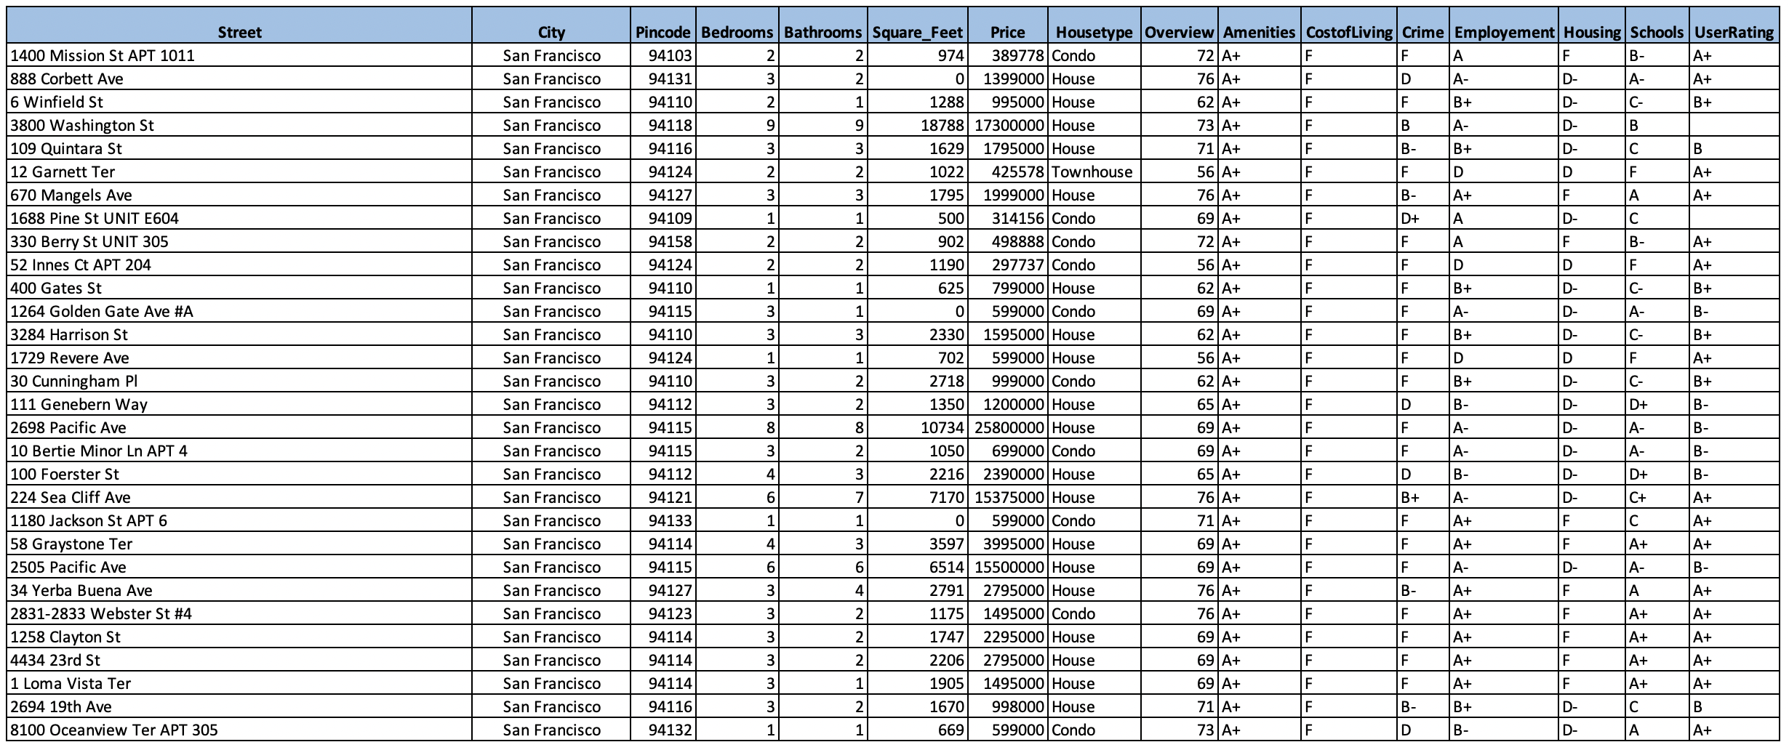
Final Data Output Snapshot

Slide 9
PART
Exploratory Data Analysis
02

Slide 10
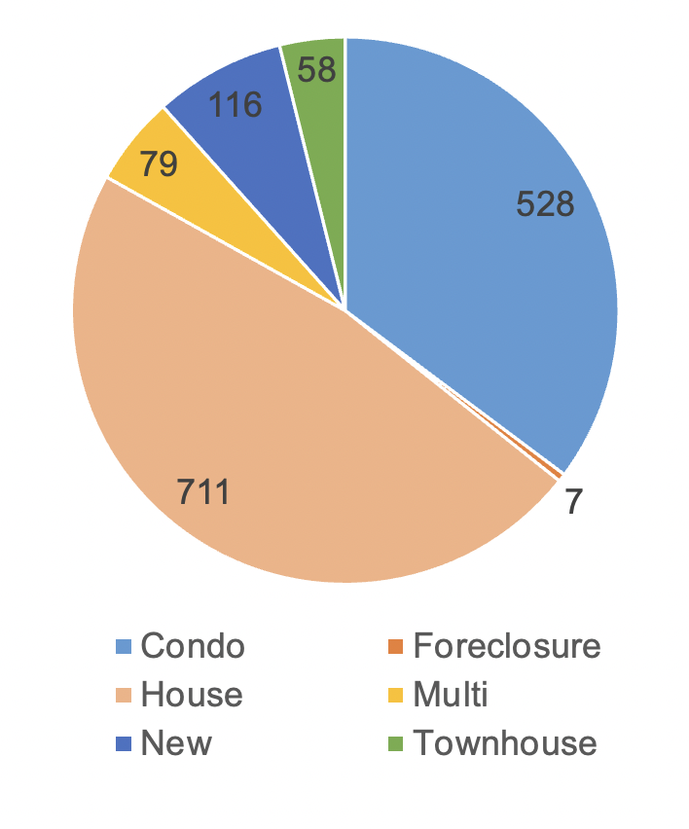
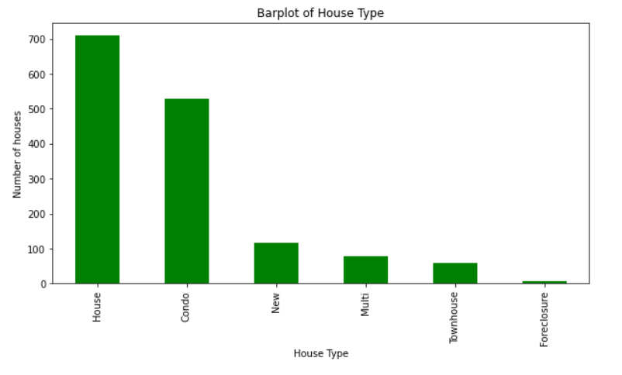
Home Types in BAY AREA
工作概

Slide 11
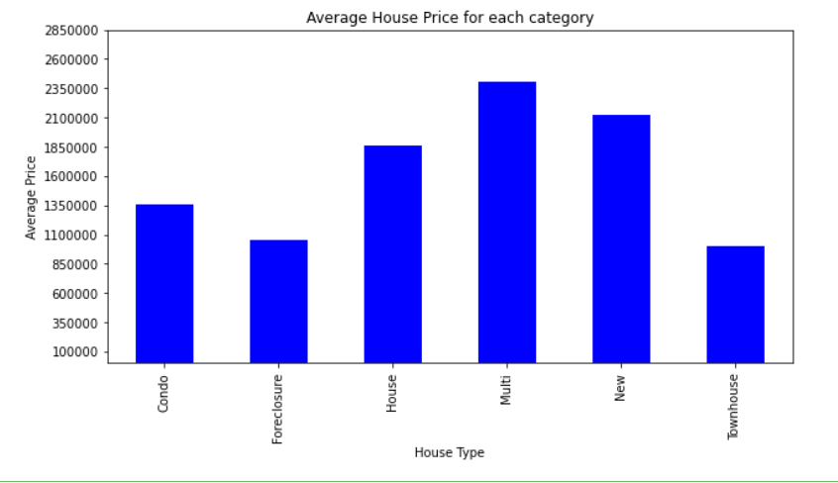
Average Price of Each House
工作概

Slide 12
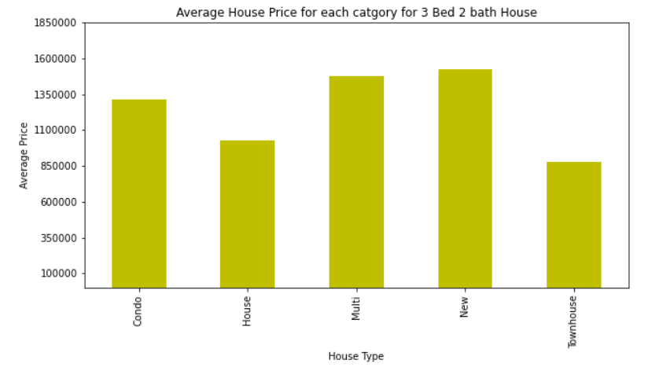
Average Price of 3 bed 2 Bath
工作概

Slide 13
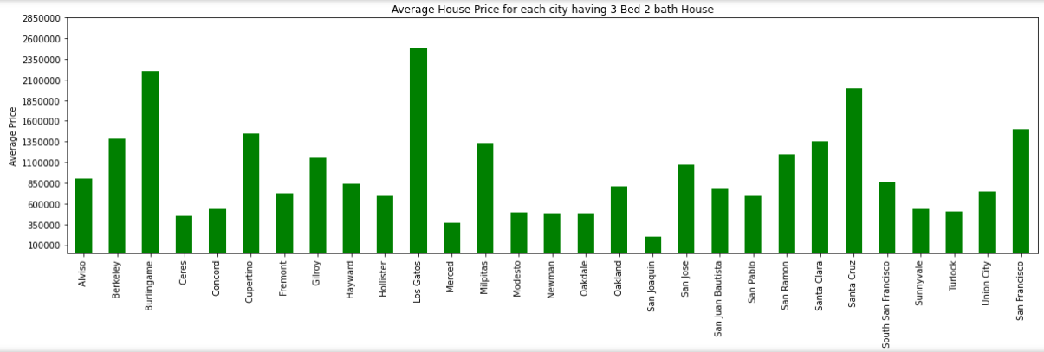
3 Bed 2 Bath for Each City
工作概

Slide 14
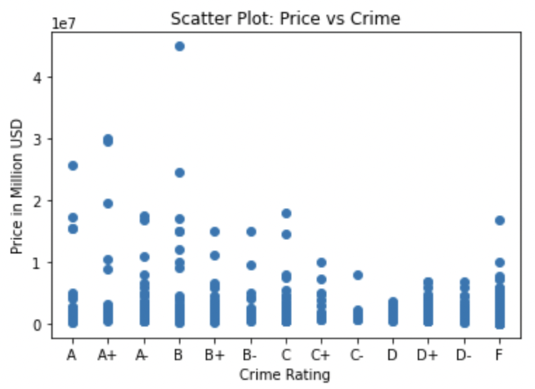
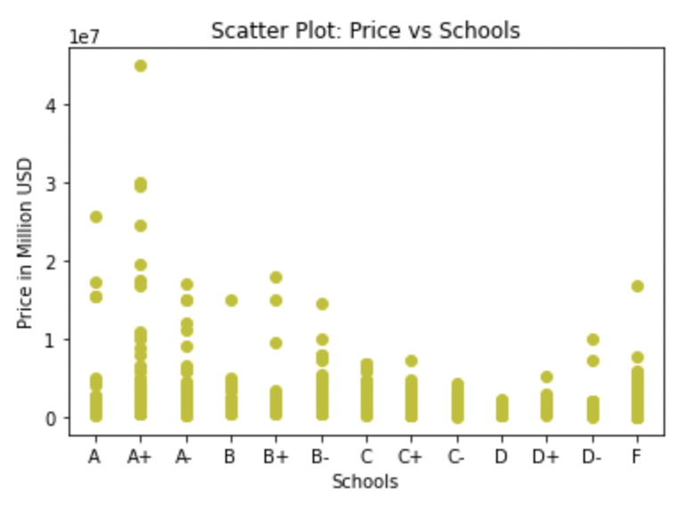
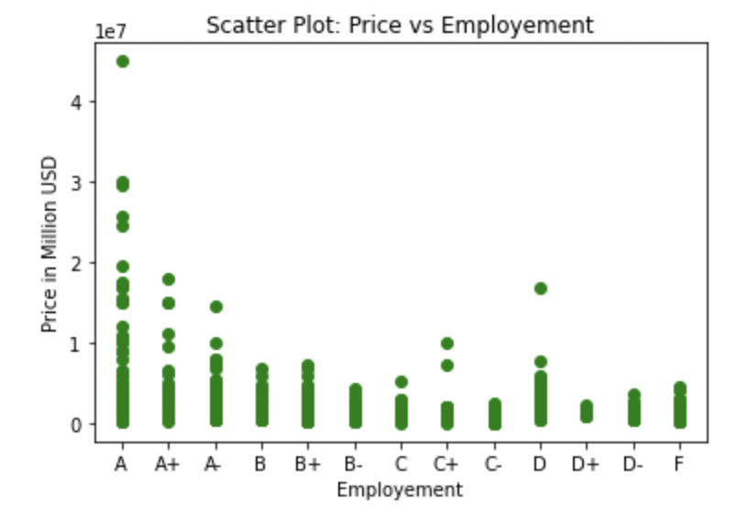
Impact of Crime, Schools and Employment
工作概

Slide 15
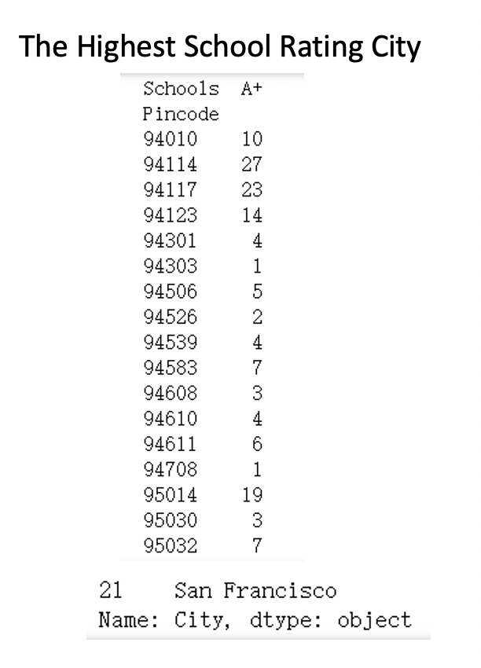
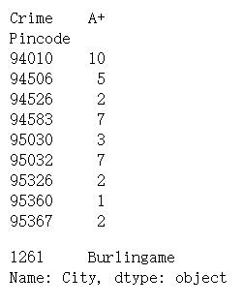
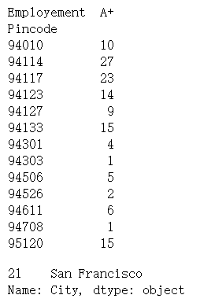
Best City With A+ category in Crime, Schools and Employment
The Safety City
The Highest Employment Rating City

Slide 16
PART
Predictive Analysis
03

Slide 17
Label encoding
Dummy Variables
Path
Selecting the best Model
Prediction
Evaluation

Slide 18
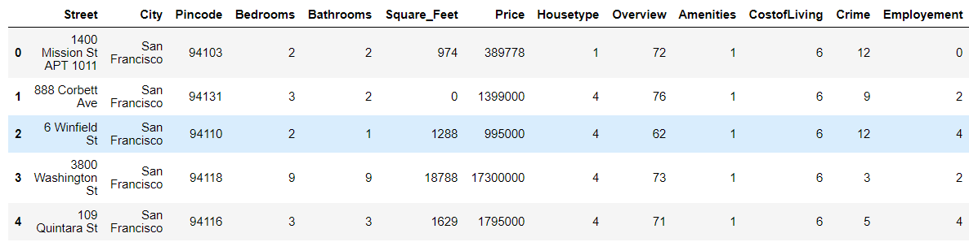
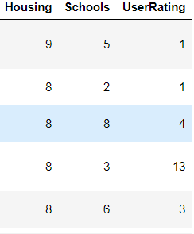
Label encoding the data

Slide 19
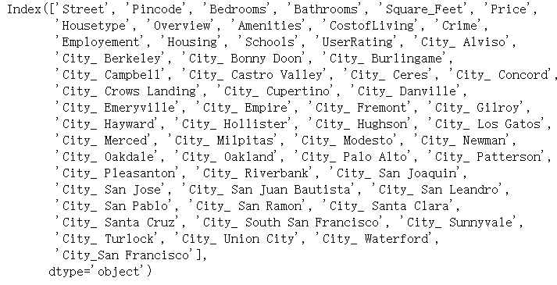
Dummy Variables

Slide 20
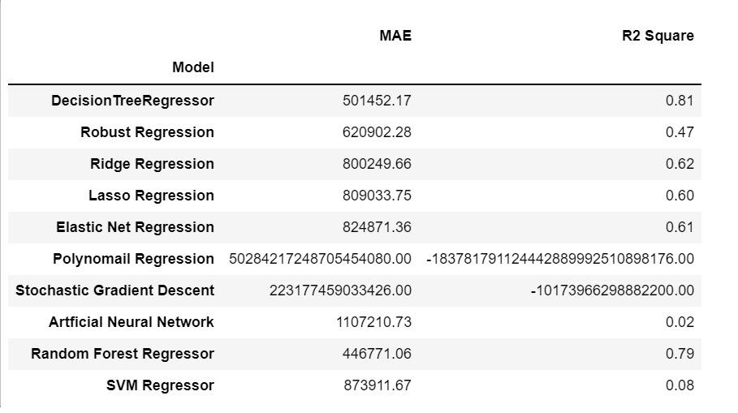
Selecting the Best Model
81 % Accuracy

Slide 21
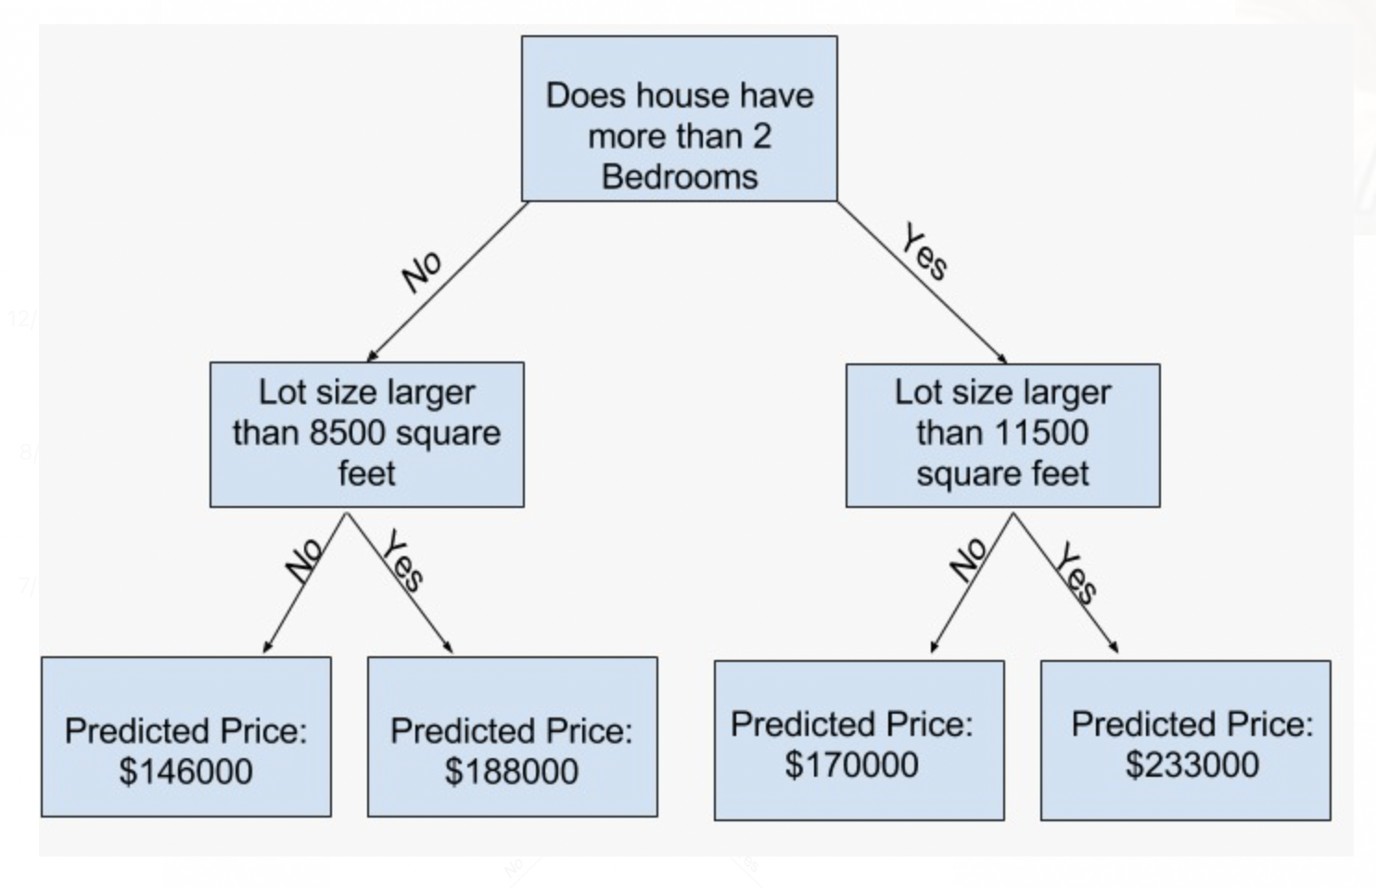
Decision Tree Algorithm

Slide 22
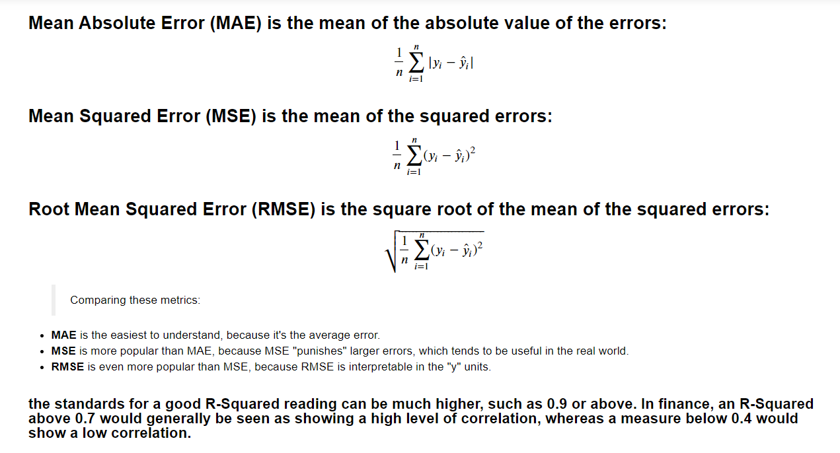

Slide 23
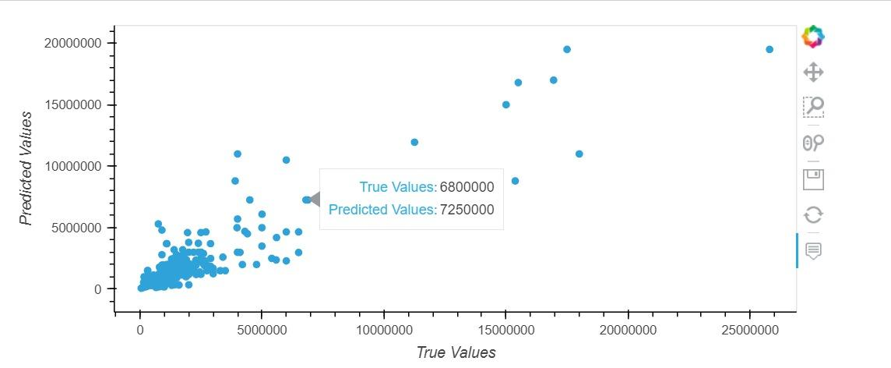
Predictive Value vs Actual Value

Slide 24
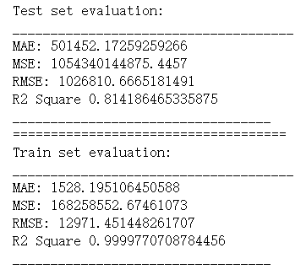
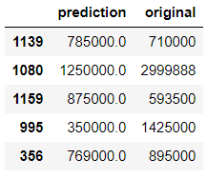
Evaluation

Slide 25
Submitted By:
Group 10:
Ajay Thakur
Celia Yao
Jingsong Feng
Canran Wang
Nageshwari Reddy Vangala

